Slide 1
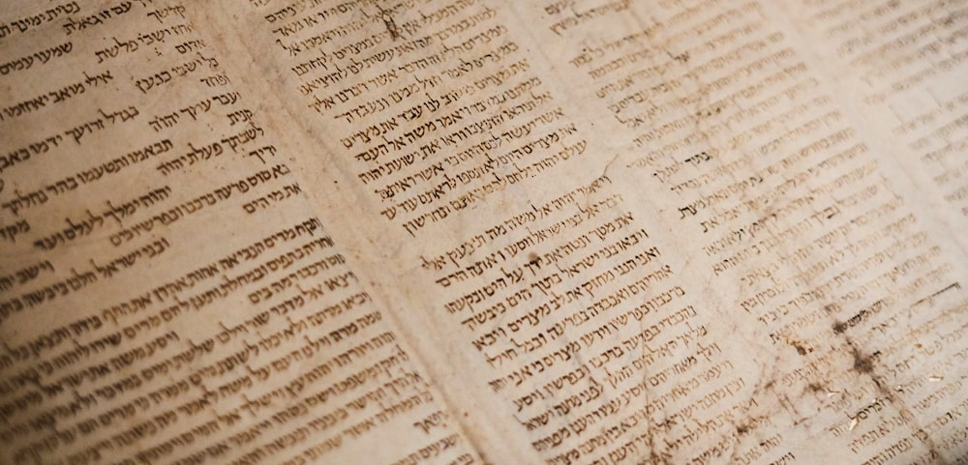
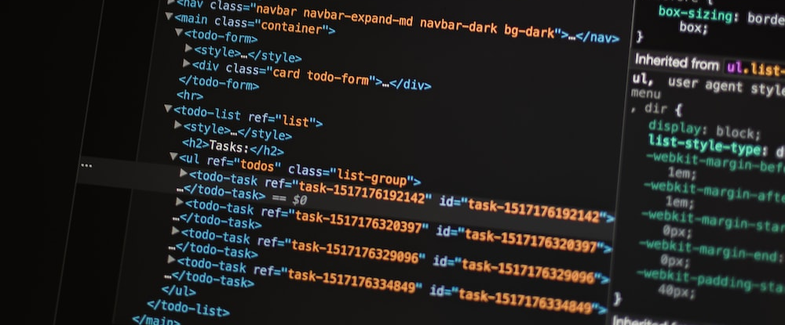
Teaching with Text Analysis
Voyant Tools

Slide 2
Workshop Goals
Explore Voyant interface
Upload and analyze historical novel
Clean data by removing stopwords
Upload and explore corpus
Ideate possible classroom applications

Slide 3

Follow Along
https://bit.ly/VoyantToolsDemo

Slide 4


The Process
Collect
Clean
Visualize & Analyze
Revise

Slide 5





Free
Web-based
Open-source
Scalable

Slide 6

Key Terms
Non-consumptive data
Natural Language Processing (NLP)
Corpus
Tokens

Slide 7
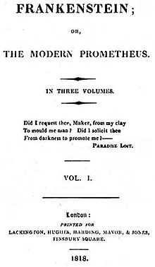
Novel Analysis
Project Gutenberg https://www.gutenberg.org/
Voyant Tools https://voyant-tools.org/

Slide 8
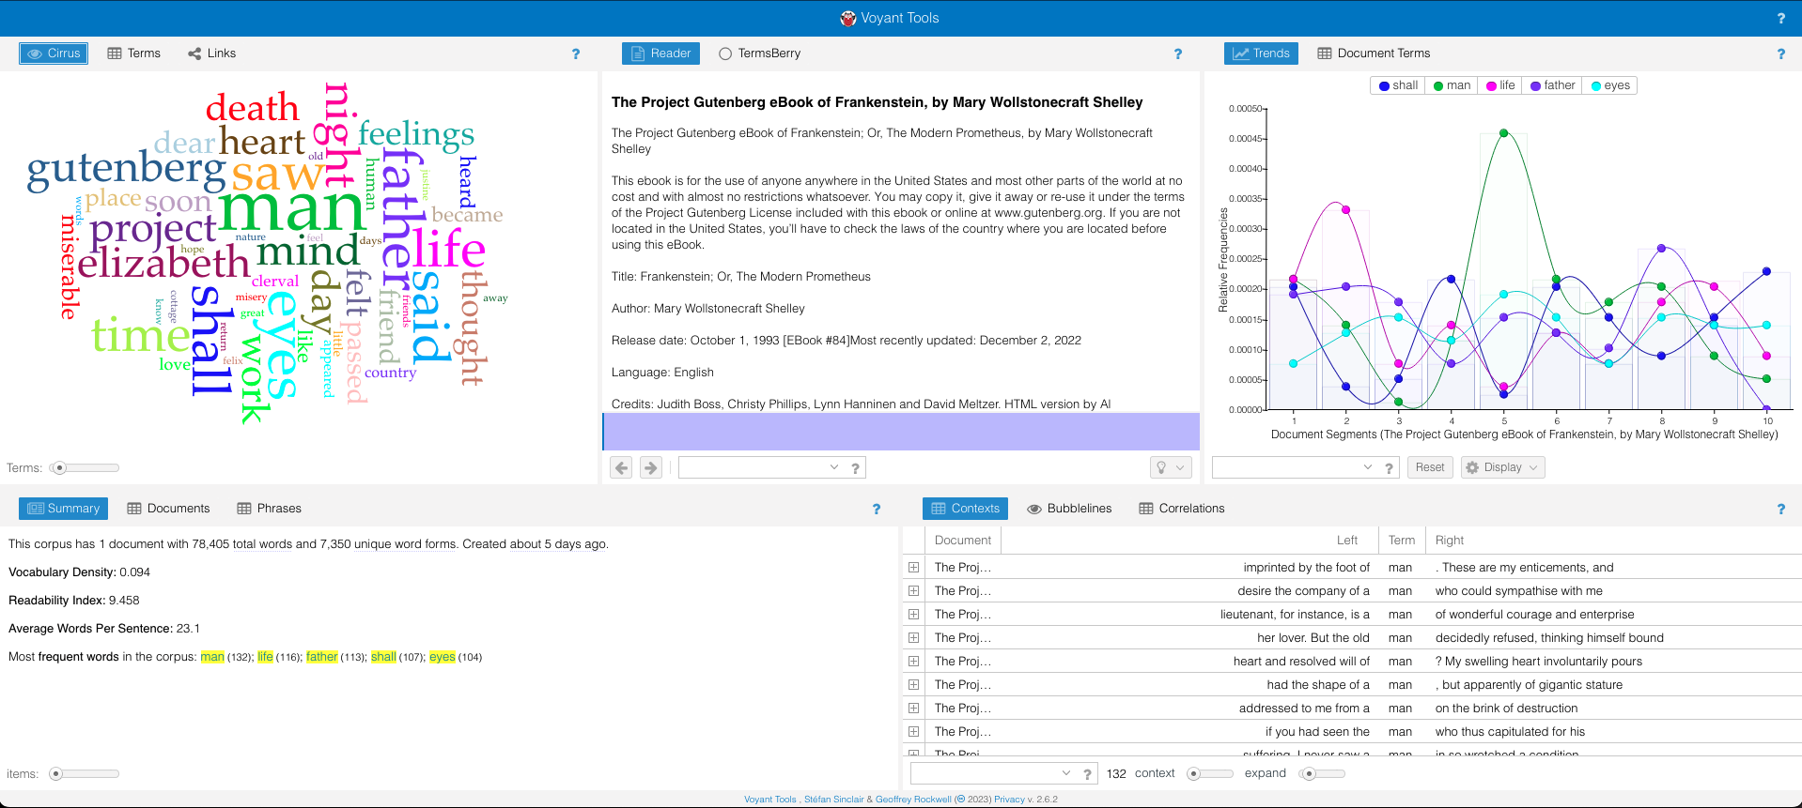

Slide 9
Stopwords
only
own
same
so
than
too
very
s
t
can
will
just
don
should
now
the
and
but
if
or
because
as
until
while
of
at
by
for
with
about
against
between
into
through
during
before
after
above
below
to
from
up
down
in
out
on
off
over
under
again
further
then
once
here
there
when
where
why
how
all
any
both
each
few
more
most
other
some
such
no
nor
not
i
me
my
myself
we
our
ours
ourselves
you
your
yours
yourself
yourselves
he
him
his
himself
she
her
hers
herself
it
its
itself
they
them
their
theirs
themselves
what
which
who
whom
this
that
these
those
am
is
are
was
were
be
been
being
have
has
had
having
do
does
did
doing
a
an
only
own

Slide 10

Corpus Analysis
Download the files in the “Corpus folder”
https://bit.ly/VoyantCorpus
Upload to new Voyant Tools tab (in order)
It will take a minute for the files to upload

Slide 11
Corpus Analysis
1500 articles sampled from American Historical Review
1900-2016
11,901,087 tokens
Sourced from ITHAKA’s Constellate platform

Slide 12
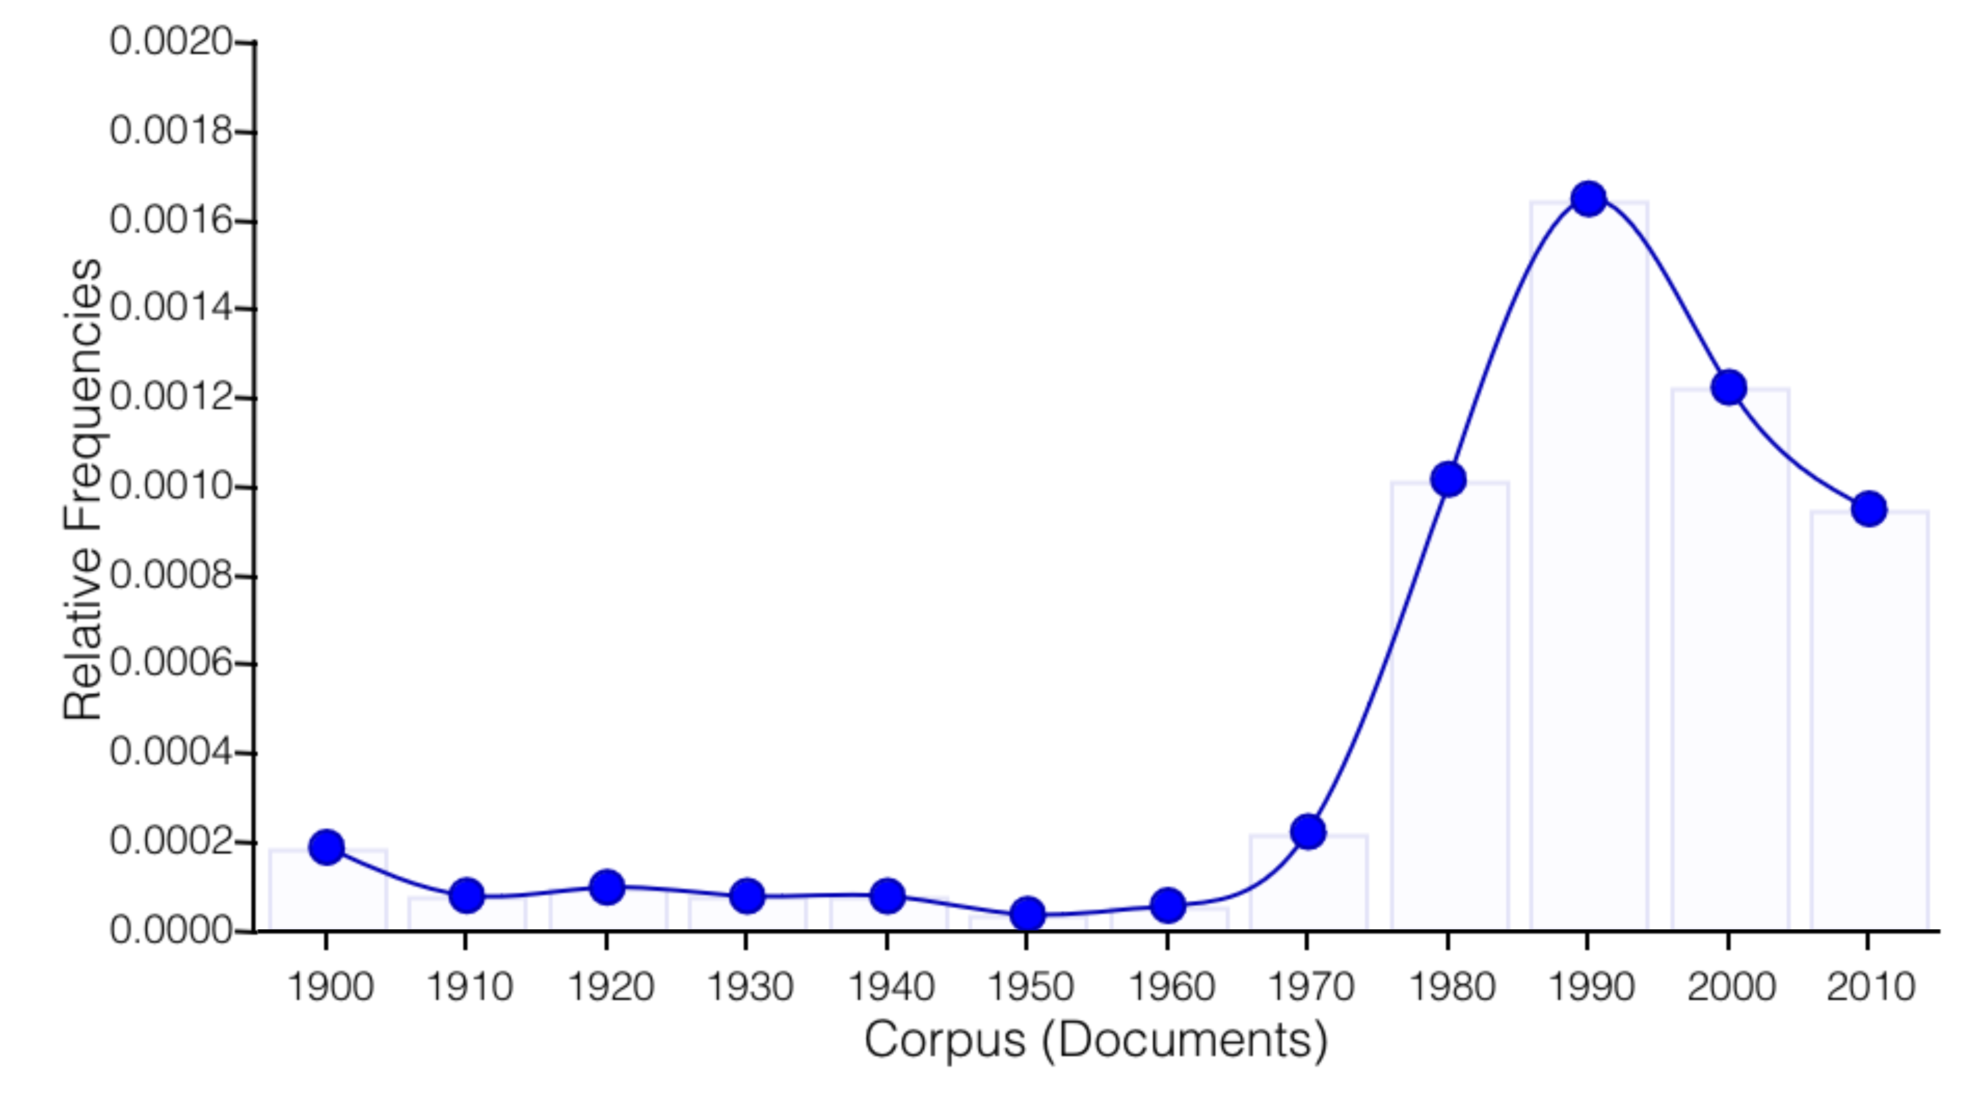
Relative Frequency of “Women”

Slide 13
Additional Applications
Sentiment Analysis
Semantic Distance
Topic Modeling
Stylometry
And many more…

